Slide 1


Holy Communion Preparation/Parents Meeting

Slide 2
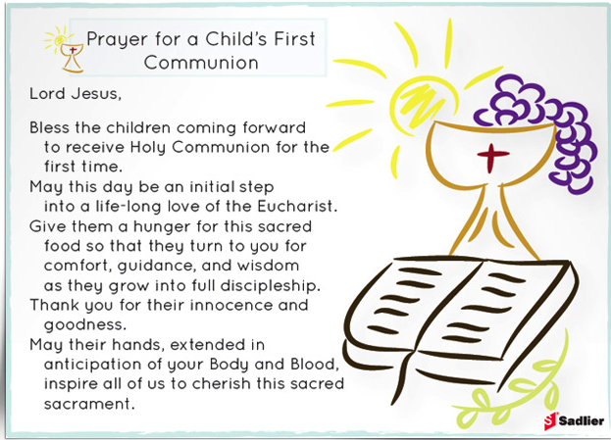

Slide 3

To gain more understanding of the ‘I Belong’ programme
Important dates for Holy Communion.

Slide 4
I Belong
Welcome to the I Belong programme.
We will be opening these books again in preparation for the children’s First Holy Communion in June.
This programme is very much based on everyday experience and encourages your child to find the deeper realities behind everyday experiences such as eating, working, getting on with each other, etc.
Each chapter looks at two stories from the Bible. One from the Old Testament and One from the New Testament.

Slide 5
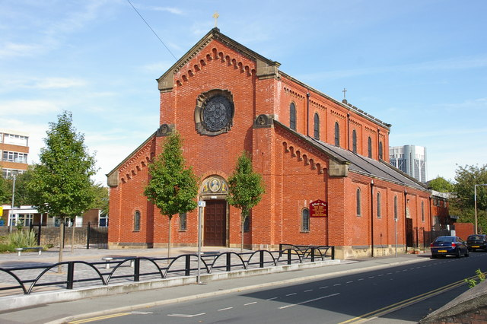

We Gather Together
It’s important to meet together regularly at church. This will help your child understand the chapters we cover and get the most out of the programme.
Sunday 17th November
Sunday 15th December
Sunday 26th January
Sunday 23rd February
Sunday 23rd March
Sunday 4th May
12:30pm

Slide 6

I Belong Catechist Sessions
Monday 4th November
Monday 27th January
Monday 10th February
Monday 3rd March
Monday 7th April
Monday 28th April
Monday 19th May
Monday 16th June
These sessions will run after school until 4:15pm
It is important that children attend these sessions. Books will be sent home for children to complete if required.

Slide 7

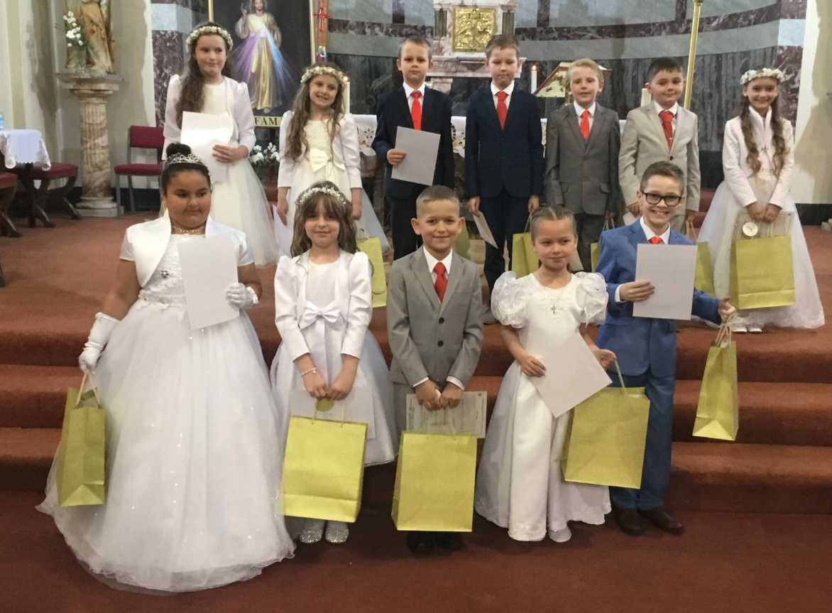
Other Important Dates
Reconciliation will take place on Thursday 6th March 2025 at 6pm.
Holy Communion will take place on Sunday 22nd June 2025 at 2:30pm.

Slide 8


Slide 9
Chapters 1-5 will prepare the children for Reconciliation.
Chapter 6 – Listening to The Word of God – readings and Parables shared in church.
Chapter 7 - The children will have been told many times about the preparation of taking the host during mass. This chapter will be looking at the understanding of what “bread” stands for.
Chapter 8 - The children will be talking about the wine we use and what this means to us.
Chapters 9 & 10 - In these chapters we come to the heart of the programme.
• We will be talking about the different reasons why we have meals.
• The Last Supper.
• In church help your child to pay extra attention to what the priest is doing at the altar as he is preparing for Holy Communion
Chapter 11 – Giving thanks

Slide 10

Questions

